Slide 1
Superintendent’s Report Dr. David Fine Peekskill City School District: A System Focused on Every Student; Every Day.
Meeting of the Board of Education
September 29, 2015

Slide 2
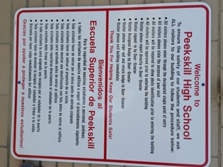
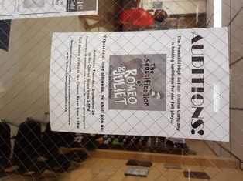
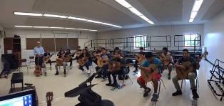
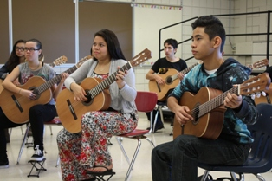
"This year we have added many new facets to our Performing Arts Department, such as dance and guitars. Here are a photos from Mr. Del Casale's Guitar & Music Theory class."

Slide 3
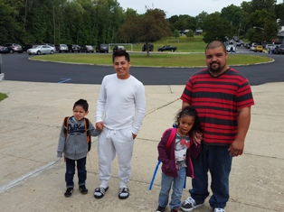
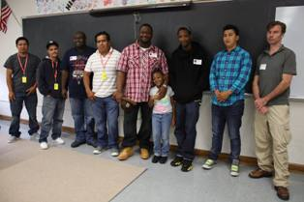
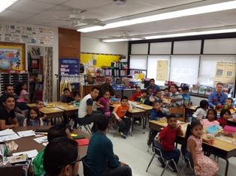
September 22^{nd:} Dads/Father Figures Take Your Child to School Day Thank you for your support and Participation: Thank you to our building leaders, staff/faculty and Lisa Aspinall-Kellawon, Tony Mitchell, Martin McDonald, and Michael Simpkins for assisting at our welcoming tables

Slide 4
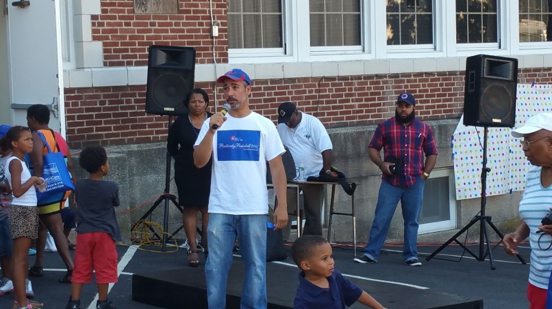
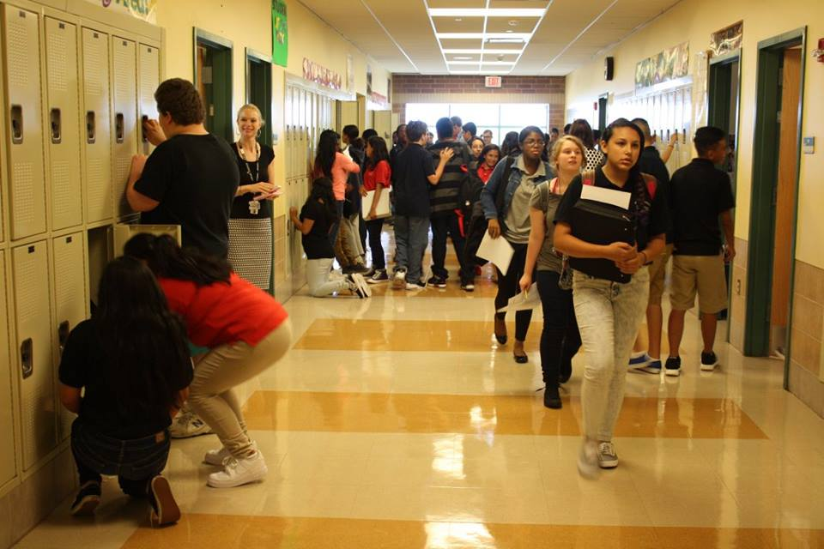
Mt. Olivet Partnership; Oakside Fun; MS Hallway; Woodside Pride

Slide 5
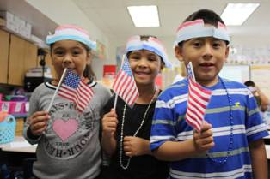
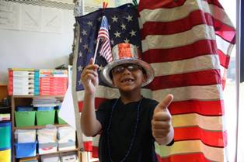
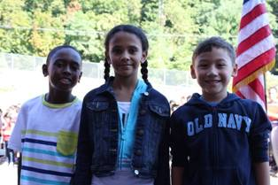
Woodside & Oakside Celebrate Constitution Day
Students at Woodside and Oakside took a moment out of their busy mornings today to gather outside at their school's flag posts so that they could celebrate Constitution Day. At Oakside, students read about what the Constitution is and why it was created, while at Woodside, students decorated hats and waved American flags. Both schools recited the Pledge of Allegiance and finished the ceremony by singing patriotic songs.

Slide 6
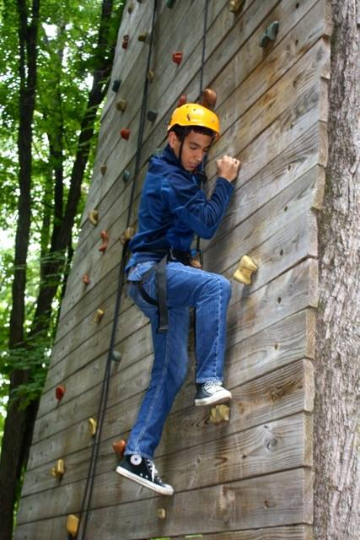
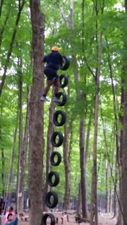
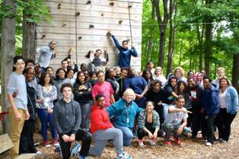
Youth Voices Center Brings New Program To Peekskill High
"During this school year, Founder and Executive Director of Youth Voices Center Inc. Michael Arterberry will facilitate 27 "Power of Peace" workshops at Peekskill High School to address leadership skills, conflict resolution, teamwork, diversity, understanding and decision making. The program, an experiential workshop that strives to allow young people to use their voice in expressing personal concerns, fears and dreams, has been proven successful in multiple school districts, including New Rochelle, Port Chester and Schenectady. The workshops are designed to help young people understand life, responsibilities and challenges and to provide them with the necessary tools to succeed, take action and create a positive impact."
Summit Academy Awarded Peekskill Education Foundation Grant for Rings Homestead Field Trip
A generous grant from the Peekskill Education Foundation enabled the Summit Academy student body and faculty/staff to spend an uplifting day at the Ring Homestead Ropes Course. The purpose of the day's program was to encourage students to meet and overcome challenges, to work together, and to cheer on each other's successes. Students encouraged each other to feats of effort and bravery - and made new friendships.

Slide 7
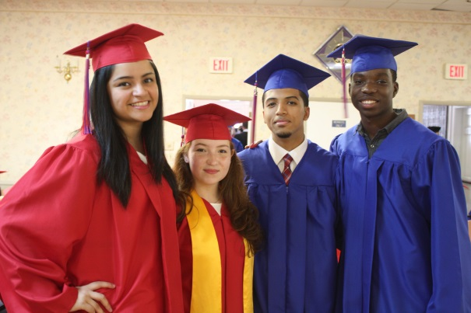
Attendance Matters: Attendance/Discipline Council A System Focused on Every Student; Every Day
Attendance Works is a national and state initiative that promotes awareness of the important role that school attendance plays in achieving academic success starting with school entry. Our goal is to ensure that every district in the country not only tracks chronic absence data beginning in kindergarten or ideally earlier, but also partners with families and community agencies to intervene when attendance is a problem for children or particular schools.

Slide 8
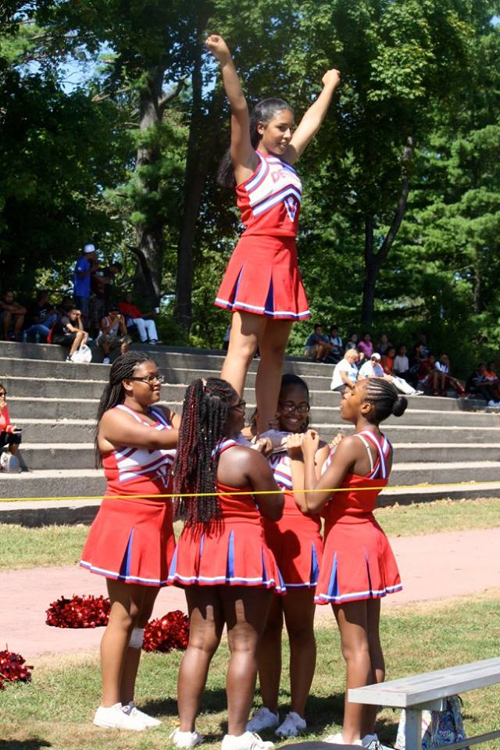
Top-Ten (10) Reasons Peekskill is a Wonderful Place to Live and Learn
10. We are life-long Learners
9. Our Residency Program
8. 5k Fun-Run/Walk (Oct. 10th)
7. Student/Athletes
6. Paved Roads and Improvements
5. Character Education
4. Peer-Peer Support
3. Focus on Best Practices
2. District Partnerships
1. Growth Mindset

Slide 9
Student Council Report
Ariel Ortiz – Presenter
PHS Student Council Report for September

Slide 10
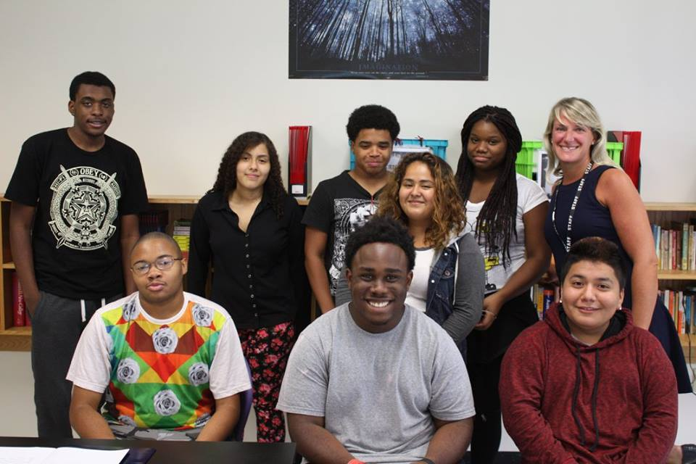
College/University and Beyond
4 or More:
We are excited to introduce the College Board’s 4 or more counselor campaign– designed to help us reach our college readiness goals. Counselors across the country will be asked to take the 4 or more pledge; encouraging all students to apply to at least four colleges. Studies show that students who apply to two colleges, rather than one, are 40% more likely to actually enroll post-high school.

Slide 11
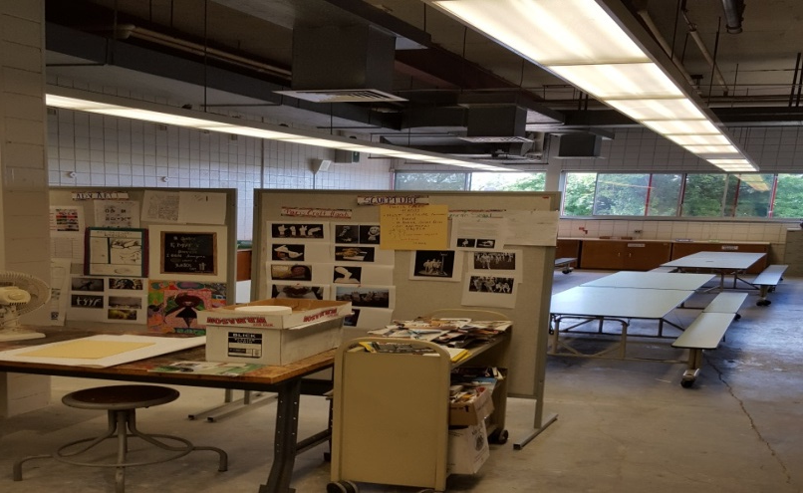
Contracts Under $10,000
Ossining Union Free School District; Health and Welfare; 2014/2015 School Year; $817.34 per pupil (4 students attending)
Dr. Marcia Delcourt; Provide continuation of Project Evaluator services; 2015/2016 School Year; Not to exceed $10,000; Funding from Community Schools Grant Initiative
Girls Scouts/Oakside; Offering a program for girls in grades K-5; 2015/2016 School Year; $0
Z Recording Studio; Provide music recording and production workshops; 2015/2016 School Year; $5,000; Funding from LEAP Grant
New Era Creative Space; Provide parenting and youth workshops; 2015/2016 School Year; $1,500; Funding from LEAP Grant
Westchester Jewish Community Services-Young People Achieve/PHS; Provide case management services, counseling sessions, community outreach services and coordinate social work services in the overall educational program; 2015/2016 School Year; $9,500; Funding through the Extended School Day/School Violence Prevention Grant
Westchester Jewish Community Services-Margaret's Place/PKMS; Provide Domestic Violence Education; 2015/2016 School Year; $0
Mad Science Contract/Uriah Hill; Provide science classes for eight Pre-K classes, September 4, 2015 - June 24, 2016; Not to Exceed $4,320; Funding through UPK Grant
Jim Rose; Provide first aid training to school district athletic coaches; July 1, 2015 - June 30, 2016;$50 per coach
Donations Under $5,000
Jacob Burns Film Center Program See Hear Feel Film/Oakside; Provide the cost of bus transportation for a maximum of 60 students to Jacob Burns, See Hear Feel Film program for a total of 12 trips; 2015/2016 School Year; Estimated cost $4,329.00.

Slide 12
Grant Allocations for 2015-16
UNIVERSAL PRE -K $437,858
PRIORITY PRE -K $326,752
21st CENTURY $926,311
TITLE IIB MATH $78,119
TITLE IIB SCIENCE $79,066
EXTENDED DAY CERTIFIED $269,790
TITLE I $948,728
SECTION 611 $807,975
SECTION 619 $41,512
TITLE IIA $181,132
MCKINNEY-VENTO CERTIFIED $40,350
TITLE IIIA IMMIGRANT $38,515
TITLE IIIA LEP CERTIFIED $104,957
COMMUNITY SCHOOLS CERTIFIED $200,000
TOTAL $4,481,065
BREAKDOWN BY OBJECT

Slide 13
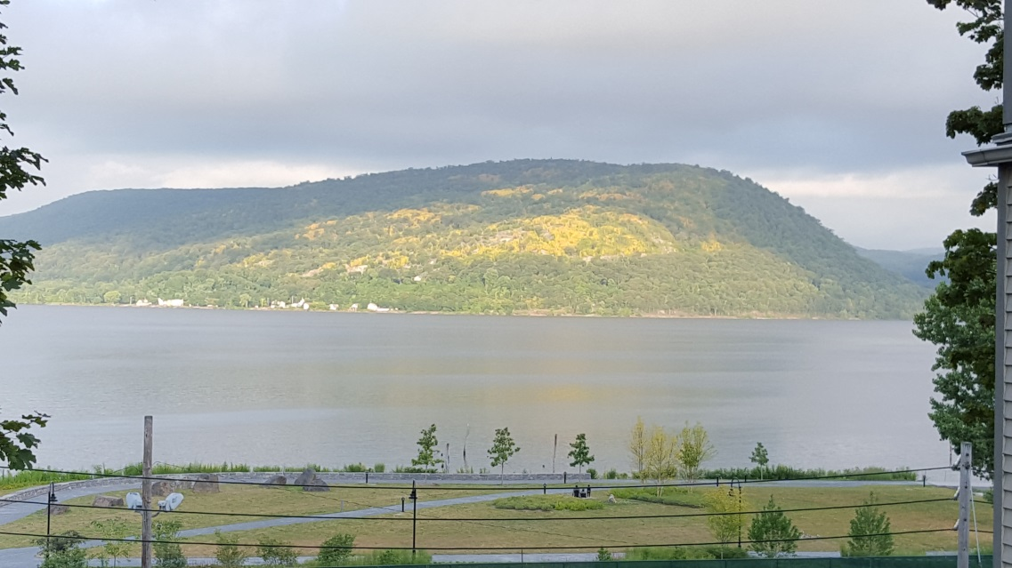
Peekskill Reminders
October 6th: Next BOE Meeting (HS, SLT), 7pm
October 10th: 5k Fun-Run; and Homecoming
October 14th: Steve Binder, College Recruit 6:30pm, PHS
October 27th: BOE Meeting
November 13th: Hall of Fame (Colonial Terrace, 6:30pm)

Slide 14
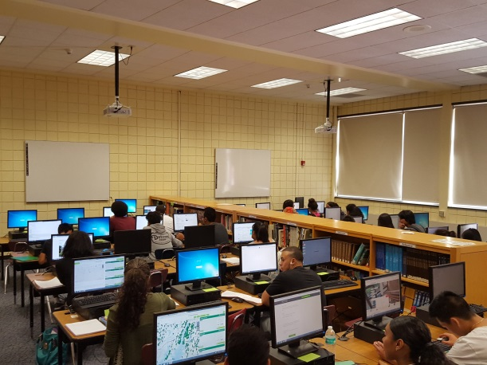
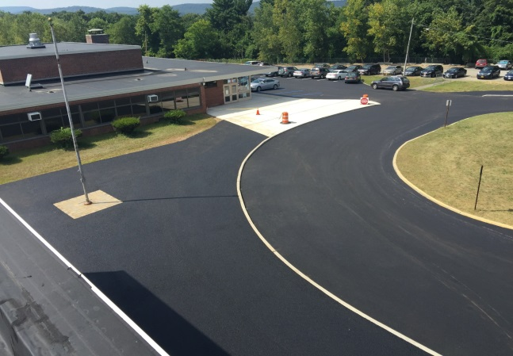
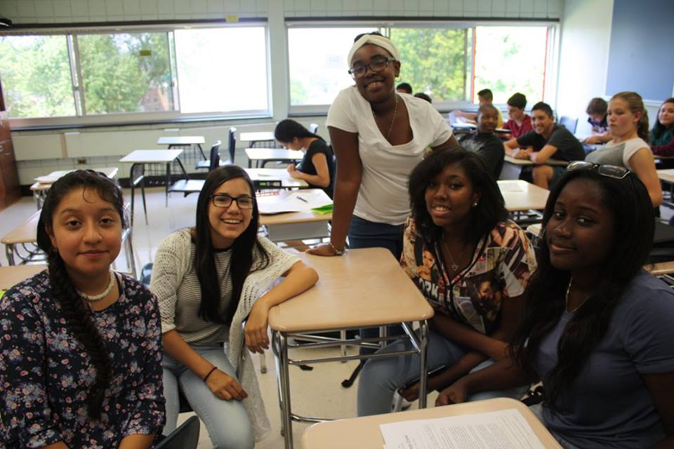
District Presentations
Carmine Crisci: Facilities/Projects Update
Joe Mosey: Enrollment/FTE (moved to 10/6)
Janice Reid/Joe Mosey: Technology Plan

Slide 15
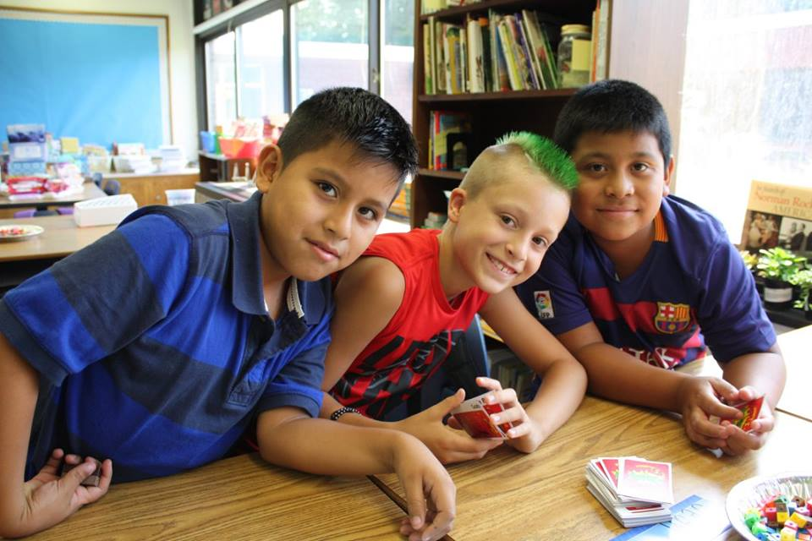
Thank You and Enjoy the Evening Have A Successful 2015-2016 School Year
*This Concludes the Superintendent’s Report
--Be Good to Yourself and Each Other--
“Be the Change you wish to see in the World.”
M. Ghandi

